Slide 1
Project Live Video Streaming and Skype Video Call using CC camera, Webcam, LED TV and Internet/Intranet.
Objective
To monitoring Overall activities of NML Workshop Via CC Camera and LED TV (42”).
Mechanics, Supervisor, floor Engineer and other official personnel can share their Problems/Experience/Views with one another via Skype.

Slide 2
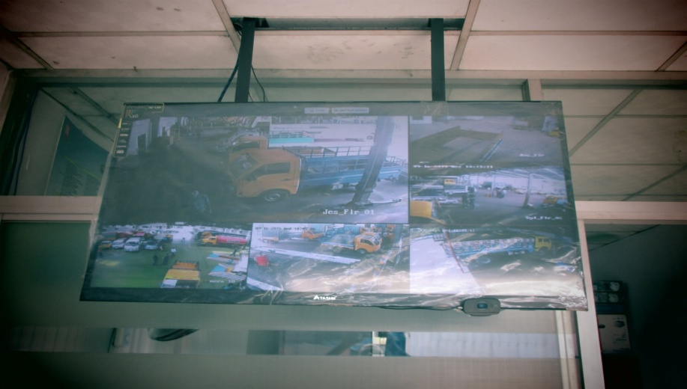
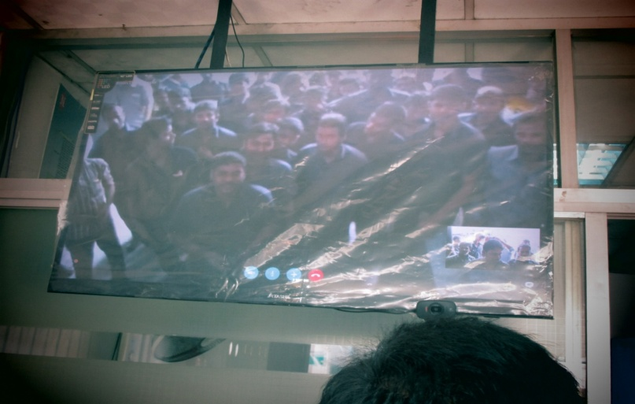
CSD BOGRA
Pic 1: Live streaming of Six Major
NML WS Activities shown
in a Single Monitor.
Pic 2: Skype with CSD jessore

Slide 3
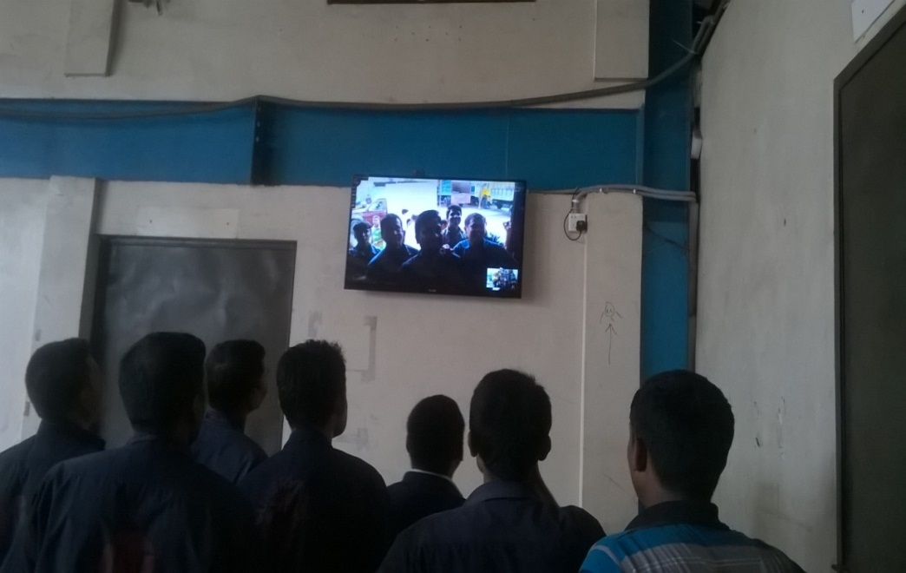
CSD JESSORE
Pic 1: Live streaming of Six Major
NML WS Activities shown
in a Single Monitor.
Pic 2: Skype with SCV konabari

Slide 4
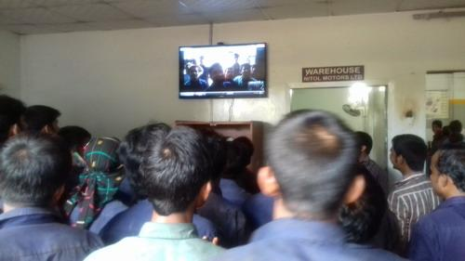
CSD MADONPUR
Pic 1: Live streaming of Six Major
NML WS Activities shown
in a Single Monitor.
Pic 2: Skype with CSD Bogra

Slide 5
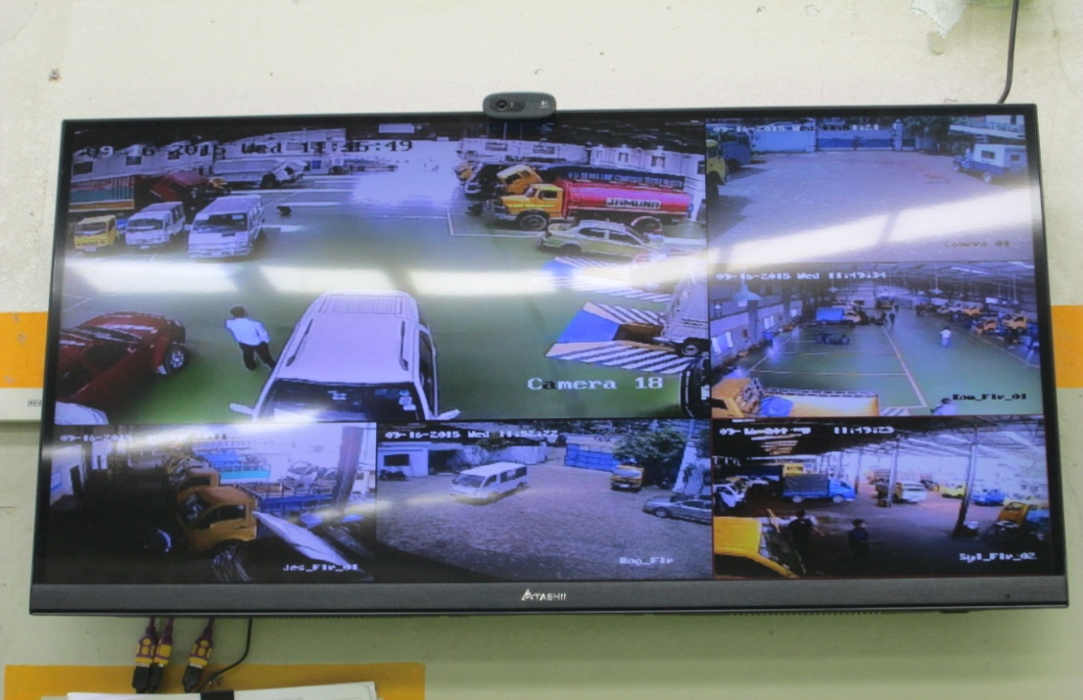
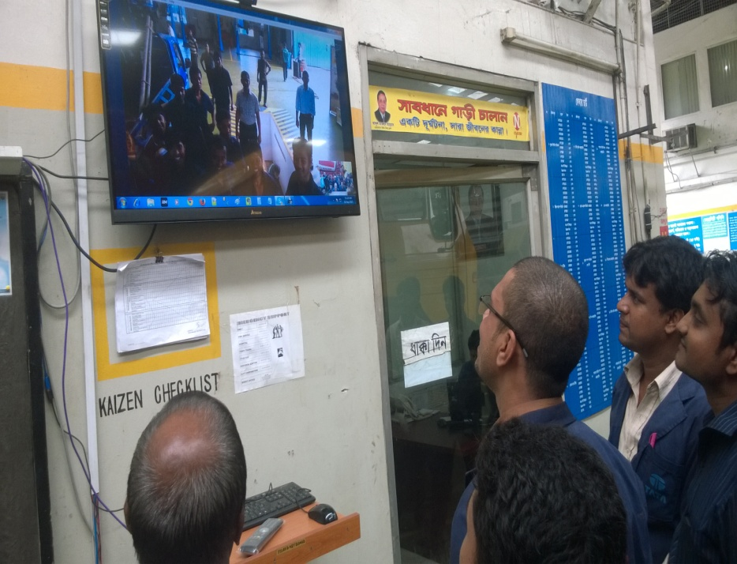
CSD TONGI
Pic 1: Live streaming of Six Major
NML WS Activities shown
in a Single Monitor.
Pic 2: Skype with SCV Konabari

Slide 6
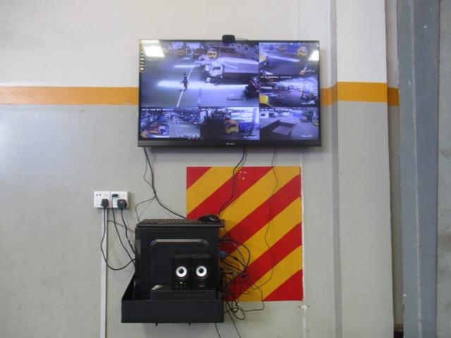
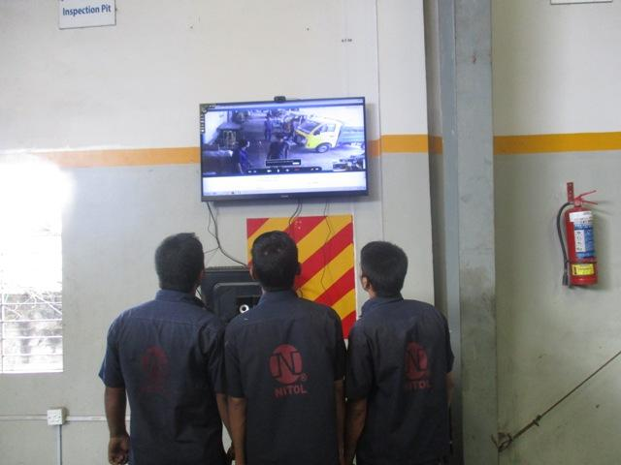
SCV KONABARI
Pic 1: Live streaming of Six Major
NML WS Activities shown
in a Single Monitor.
Pic 2: Skype with CSD Jessore

Slide 7
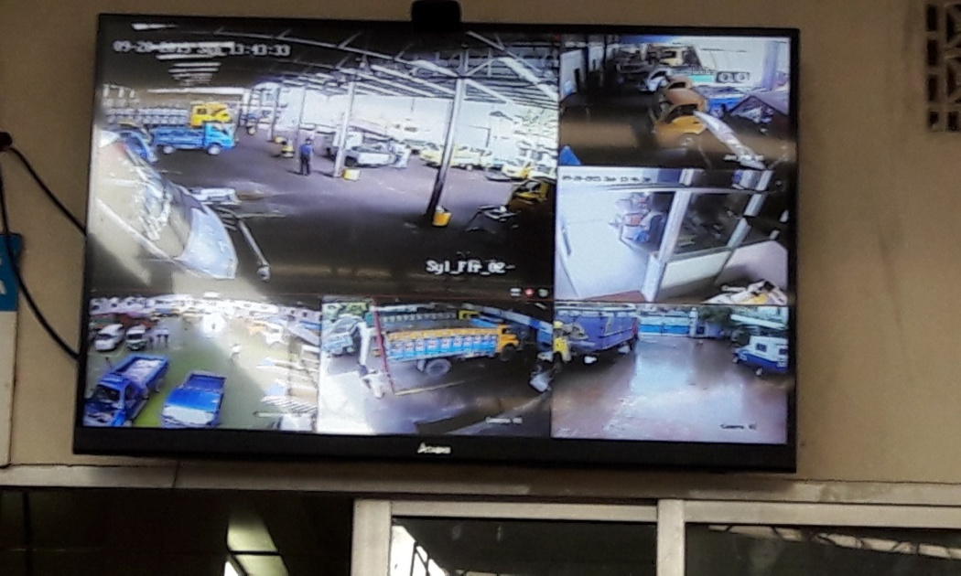
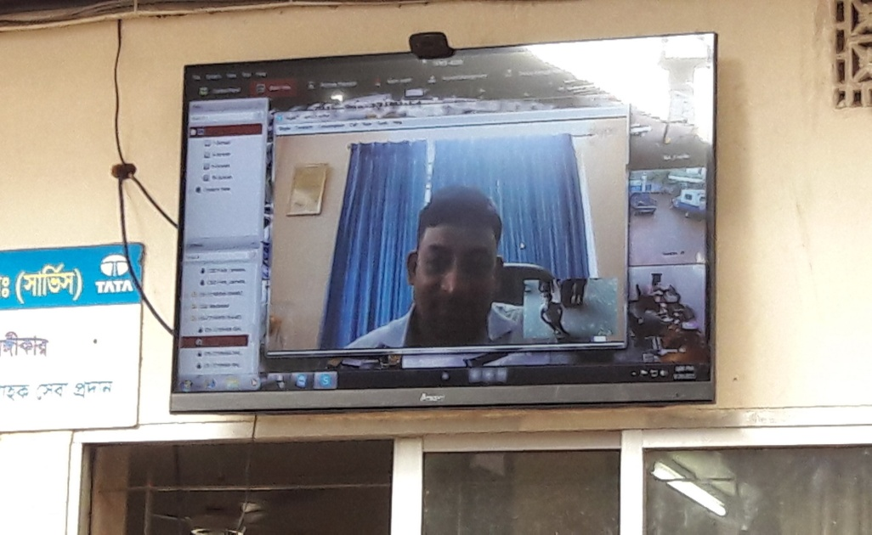
CSD SYLHET
Pic 1: Live streaming of Six Major
NML WS Activities shown
in a Single Monitor.
Pic 2: Skype with CSD Rajshahi

Slide 8
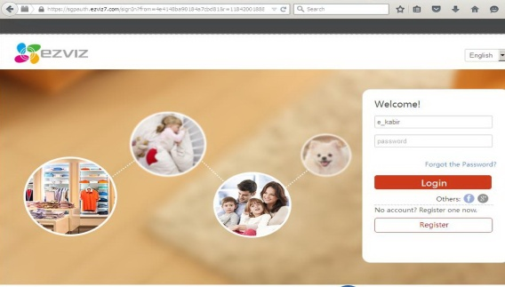
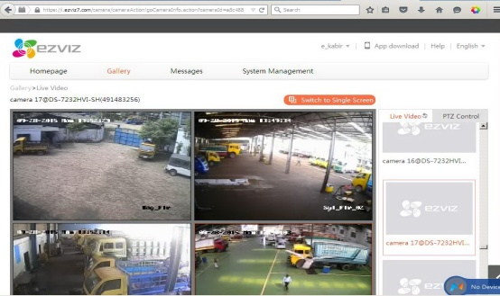
Important Notes
From any network and any where, you can see/view live streaming of our Six(6) major workshop, please go to the below website: https://www.ezviz7.com/ then click on login option.
use user name: e_kabir and password:EK12345
Go to the gallery option and view the live camera one after one .
Login Screen Live Video Streaming

Slide 9
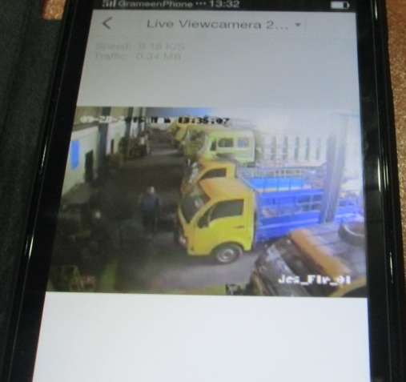
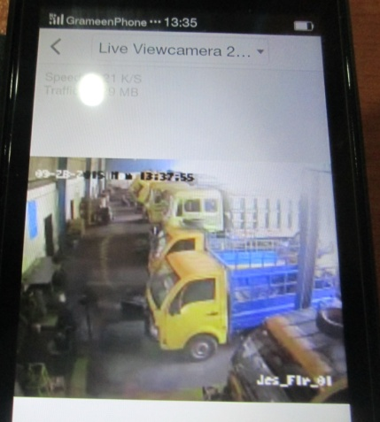
You can See/view this live Streaming on your android or I phone using eizviz apps. you can download this apps from ftp site: ftp://115.69.211.52 and go to shareall then folder IT(ftp://115.69.211.52/Shareall/IT/) using username: shareall and password:123456
Mobile View using ezviz apps

Slide 10
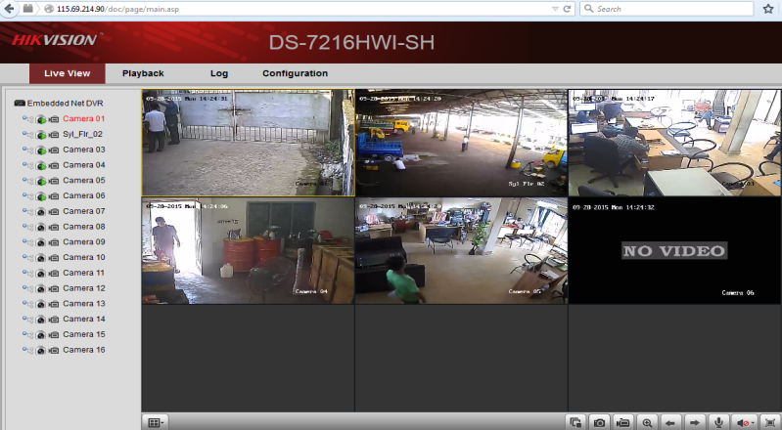
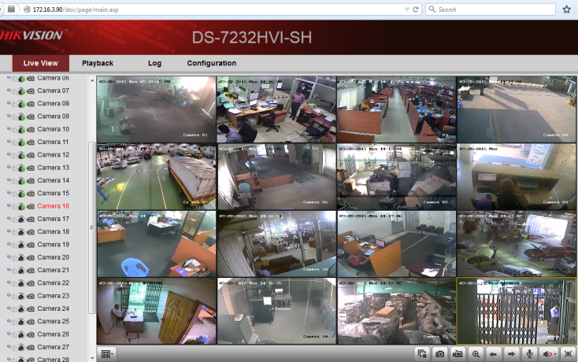
For better video streaming (full motion),please use our following local Address or local LAN with browser(Firefox):
CSD Tongi:172.16.3.90
CSD Madanpur:172.16.3.254
SCV Konabari:172.16.0.207
CSD Jessore:172.16.0.203
CSD Bogra:103.229.46.18
CSD Sylhet:115.69.214.90
User name: Guest password:123456
For any query please contact IT Dept. of NML Service and Parts. Hot Line:01713140222

